Slide 1
Angle Modulation
Gaurav S. Kasbekar
Dept. of Electrical Engineering
IIT Bombay

Slide 2
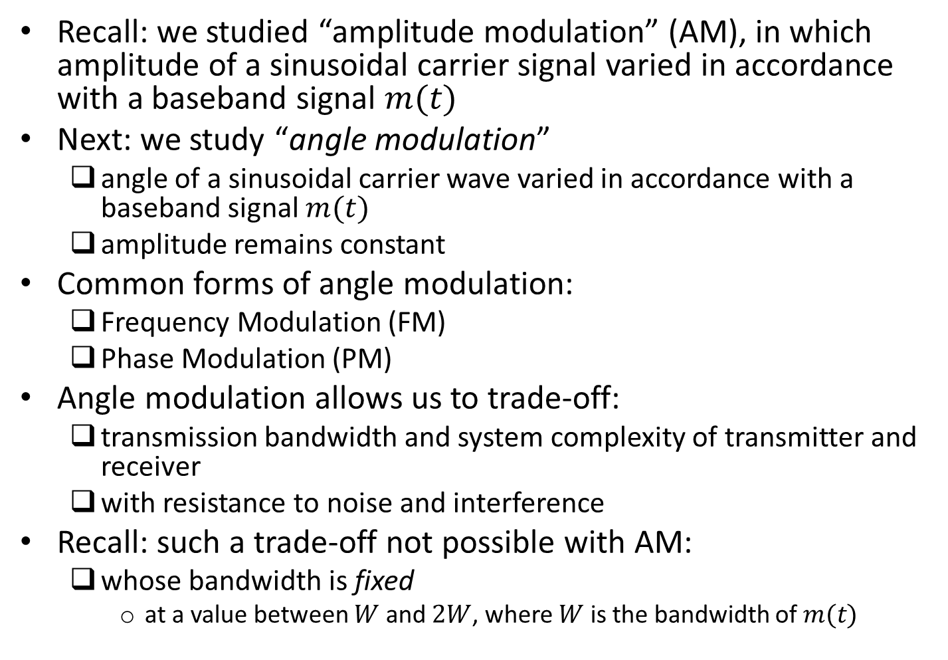
Introduction
Recall: we studied “amplitude modulation” (AM), in which amplitude of a sinusoidal carrier signal varied in accordance with a baseband signal $m(t)$
Next: we study “angle modulation”
angle of a sinusoidal carrier wave varied in accordance with a baseband signal $m(t)$
amplitude remains constant
Common forms of angle modulation:
Frequency Modulation (FM)
Phase Modulation (PM)
Angle modulation allows us to trade-off:
transmission bandwidth and system complexity of transmitter and receiver
with resistance to noise and interference
Recall: such a trade-off not possible with AM:
whose bandwidth is fixed
at a value between $W$ and $2W$, where $W$ is the bandwidth of $m(t)$

Slide 3
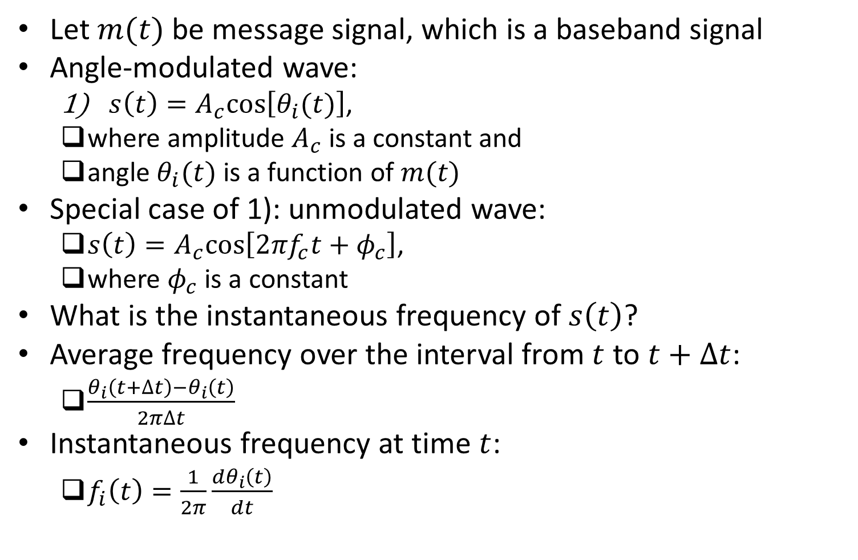
Angle-Modulated Wave and Its Instantaneous Frequency
Let $m(t)$ be message signal, which is a baseband signal
Angle-modulated wave:
$s\left(t\right)=A_{c}cos\left[θ_{i}(t)\right]$,
where amplitude $A_{c}$ is a constant and
angle $θ_{i}(t)$ is a function of $m(t)$
Special case of 1): unmodulated wave:
$s\left(t\right)=A_{c}cos\left[2πf_{c}t+φ_{c}\right]$,
where $φ_{c}$ is a constant
What is the instantaneous frequency of $s\left(t\right)$?
Average frequency over the interval from $t$ to $t+∆t$:
$\frac{θ_{i}\left(t+∆t\right)−θ_{i}\left(t\right)}{2π∆t}$
Instantaneous frequency at time $t$:
$f_{i}\left(t\right)=\frac{1}{2π}\frac{{dθ}_{i}\left(t\right)}{dt}$

Slide 4
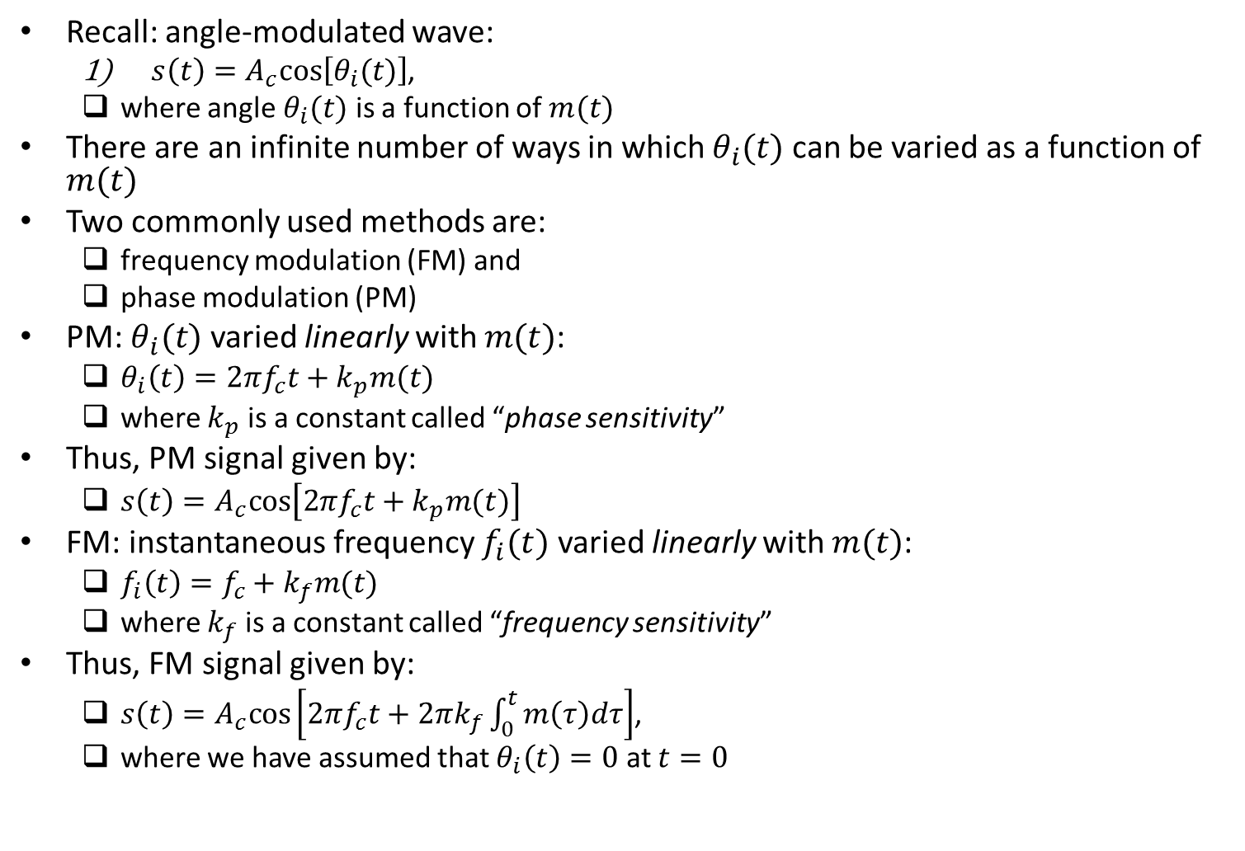
FM and PM
Recall: angle-modulated wave:
$s\left(t\right)=A_{c}cos\left[θ_{i}(t)\right]$,
where angle $θ_{i}(t)$ is a function of $m(t)$
There are an infinite number of ways in which $θ_{i}(t)$ can be varied as a function of $m(t)$
Two commonly used methods are:
frequency modulation (FM) and
phase modulation (PM)
PM: $θ_{i}(t)$ varied linearly with $m(t)$:
$θ_{i}\left(t\right)=2πf_{c}t+k_{p}m(t)$
where $k_{p}$ is a constant called “phase sensitivity”
Thus, PM signal given by:
$s\left(t\right)=A_{c}cos\left[2πf_{c}t+k_{p}m(t)\right]$
FM: instantaneous frequency $f_{i}(t)$ varied linearly with $m(t)$:
$f_{i}\left(t\right)=f_{c}+k_{f}m(t)$
where $k_{f}$ is a constant called “frequency sensitivity”
Thus, FM signal given by:
$s\left(t\right)=A_{c}cos\left[2πf_{c}t+2πk_{f}\int_{0}^{t}{m\left(τ\right)dτ}\right]$,
where we have assumed that $θ_{i}\left(t\right)=0$ at $t=0$

Slide 5
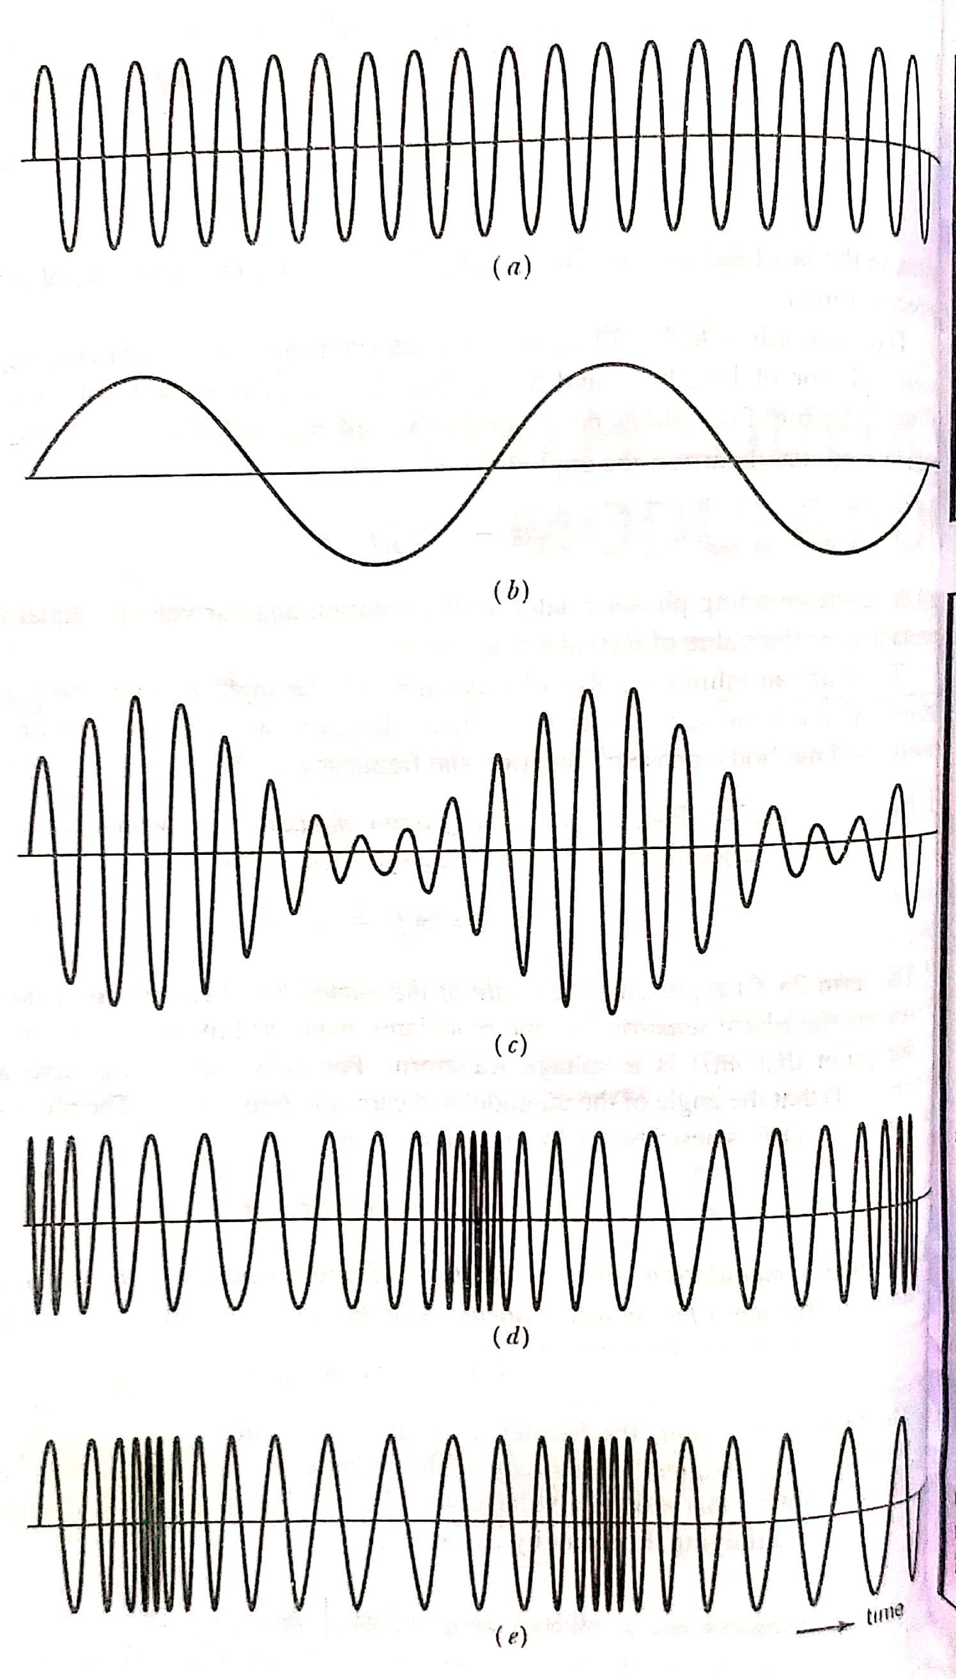
Example
Fig. shows (a) carrier wave, (b) message signal and corresponding (c) AM signal, (d) PM signal, (e) FM signal
Ref: “Communication Systems” by S. Haykin and M. Moher, 5th ed

Slide 6
Properties of Angle-Modulated Waves

Slide 7
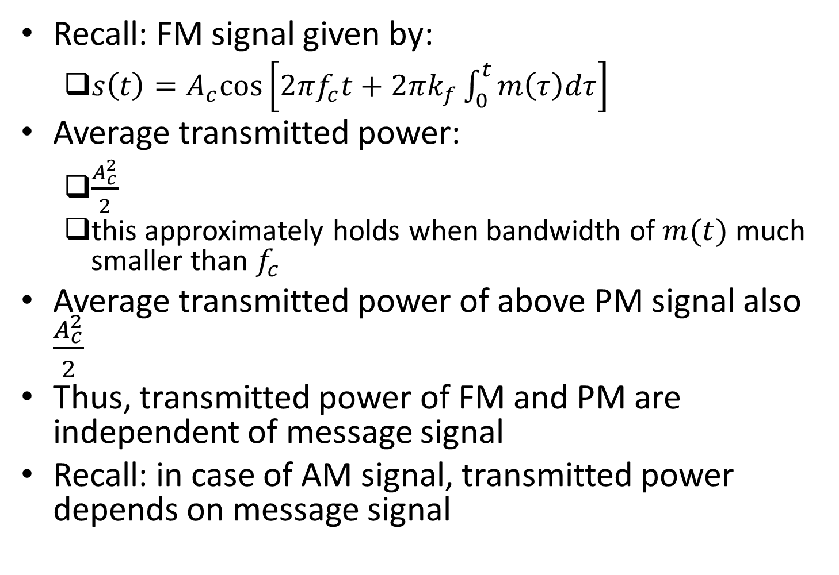
Transmitted Power of Angle-Modulated Signals
Recall: FM signal given by:
$s\left(t\right)=A_{c}cos\left[2πf_{c}t+2πk_{f}\int_{0}^{t}{m\left(τ\right)dτ}\right]$
Average transmitted power:
$\frac{A_{c}^{2}}{2}$
this approximately holds when bandwidth of $m(t)$ much smaller than $f_{c}$
Average transmitted power of above PM signal also $\frac{A_{c}^{2}}{2}$
Thus, transmitted power of FM and PM are independent of message signal
Recall: in case of AM signal, transmitted power depends on message signal

Slide 8
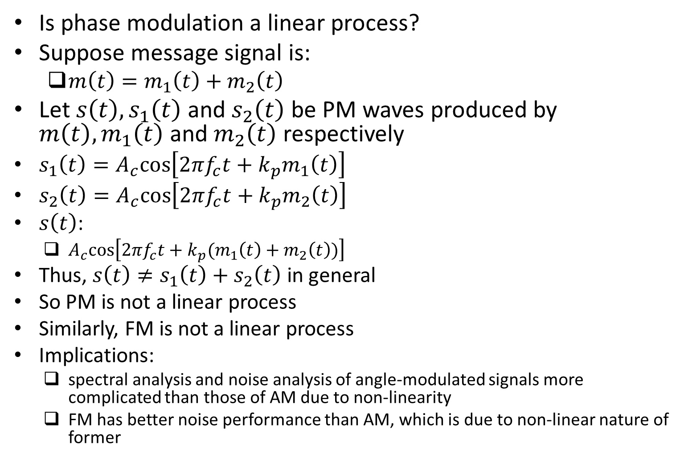
Linearity of Modulation Process
Is phase modulation a linear process?
Suppose message signal is:
$m\left(t\right)=m_{1}\left(t\right)+m_{2}\left(t\right)$
Let $s\left(t\right),s_{1}\left(t\right)$ and $s_{2}\left(t\right)$ be PM waves produced by $m\left(t\right),m_{1}\left(t\right)$ and $m_{2}\left(t\right)$ respectively
$s_{1}\left(t\right)=A_{c}cos\left[2πf_{c}t+k_{p}m_{1}\left(t\right)\right]$
$s_{2}\left(t\right)=A_{c}cos\left[2πf_{c}t+k_{p}m_{2}\left(t\right)\right]$
$s\left(t\right)$:
$A_{c}cos\left[2πf_{c}t+k_{p}(m_{1}\left(t\right)+m_{2}\left(t\right))\right]$
Thus, $s\left(t\right)≠s_{1}\left(t\right)+s_{2}\left(t\right)$ in general
So PM is not a linear process
Similarly, FM is not a linear process
Implications:
spectral analysis and noise analysis of angle-modulated signals more complicated than those of AM due to non-linearity
FM has better noise performance than AM, which is due to non-linear nature of former

Slide 9
Zero-Crossings and Visualization Difficulty of Message Waveform
Recall: in AM, assuming no overmodulation:
zero-crossings are regularly spaced apart
However, this is not the case in FM and PM
Recall: in AM, message signal is envelope of modulated wave (assuming that carrier wave is not overmodulated):
so envelope detection can be used to easily recover message signal from modulated wave
In case of angle modulated wave, not easy to visualize message signal by looking at modulated wave

Slide 10
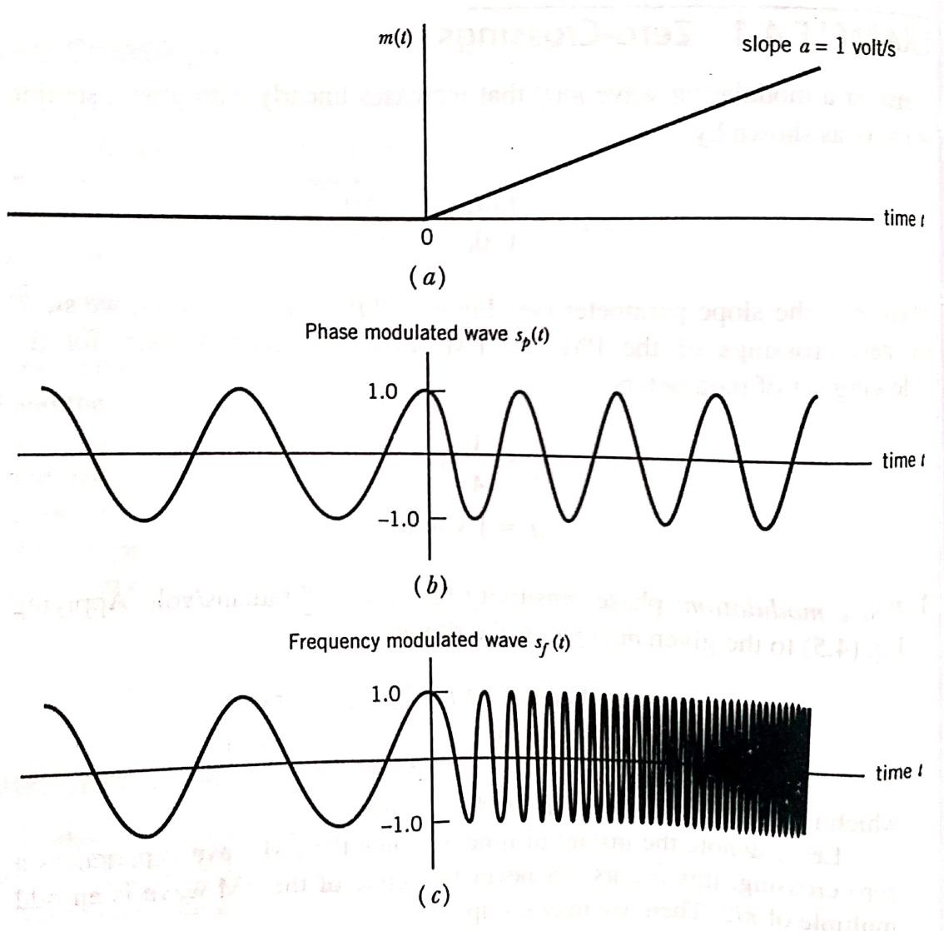
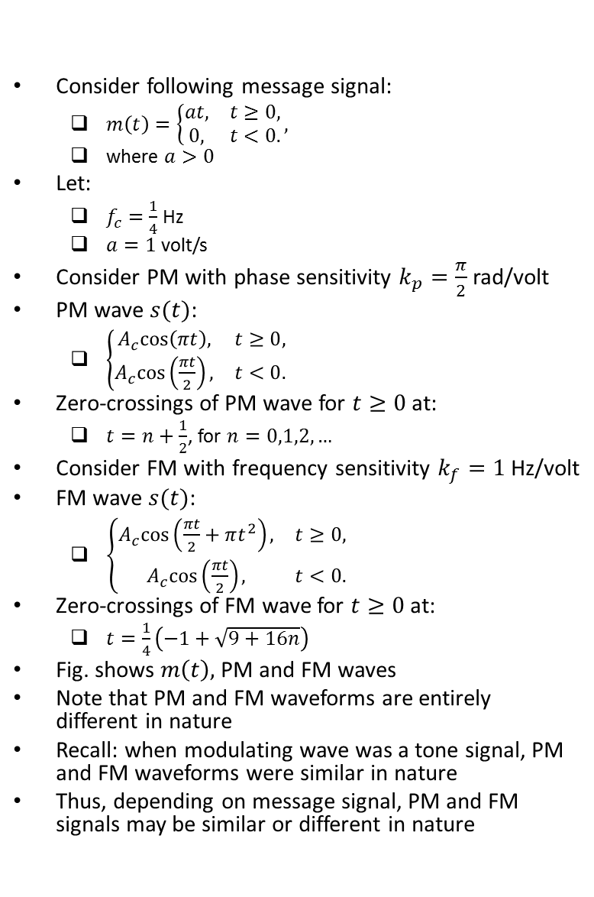
Example: Zero-Crossings
Consider following message signal:
$m\left(t\right)=\left\{\begin{matrix}at, & t≥0, \\ 0, & t<0.\end{matrix}\right.,$
where $a>0$
Let:
$f_{c}=\frac{1}{4}$ Hz
$a=1$ volt/s
Consider PM with phase sensitivity $k_{p}=\frac{π}{2}$ rad/volt
PM wave $s(t)$:
$\left\{\begin{matrix}A_{c}cos\left(πt\right), & t≥0, \\ A_{c}cos\left(\frac{πt}{2}\right), & t<0.\end{matrix}\right.$
Zero-crossings of PM wave for $t≥0$ at:
$t=n+\frac{1}{2}$, for $n=0,1,2,…$
Consider FM with frequency sensitivity $k_{f}=1$ Hz/volt
FM wave $s(t)$:
$\left\{\begin{matrix}A_{c}cos\left(\frac{πt}{2}+πt^{2}\right), & t≥0, \\ A_{c}cos\left(\frac{πt}{2}\right), & t<0.\end{matrix}\right.$
Zero-crossings of FM wave for $t≥0$ at:
$t=\frac{1}{4}\left(−1+\sqrt{9+16n}\right)$
Fig. shows $m\left(t\right),$ PM and FM waves
Note that PM and FM waveforms are entirely different in nature
Recall: when modulating wave was a tone signal, PM and FM waveforms were similar in nature
Thus, depending on message signal, PM and FM signals may be similar or different in nature
Ref: “Communication Systems” by S. Haykin and M. Moher, 5th ed

Slide 11
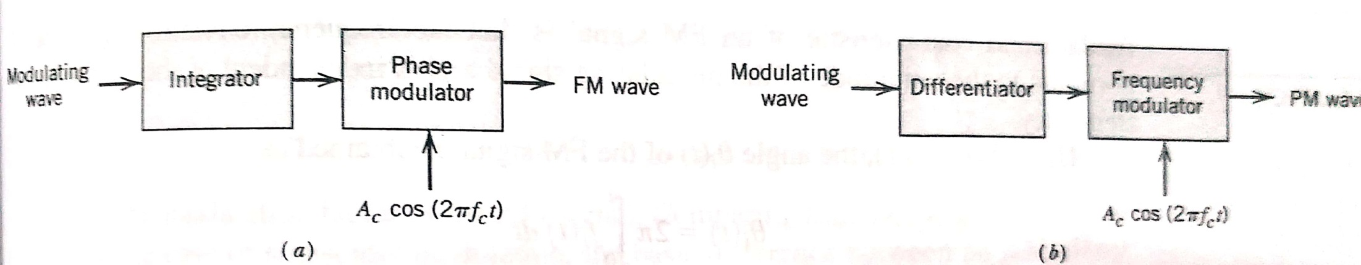
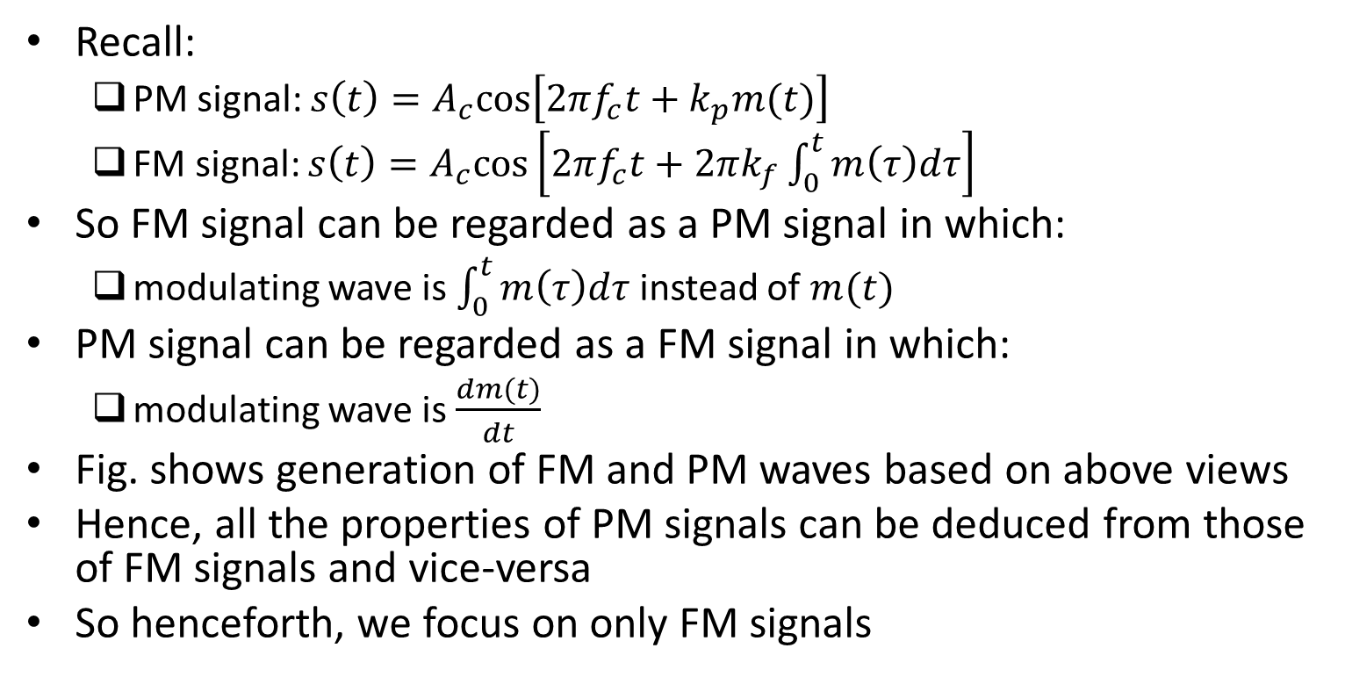
Relationship Between FM and PM
Recall:
PM signal: $s\left(t\right)=A_{c}cos\left[2πf_{c}t+k_{p}m(t)\right]$
FM signal: $s\left(t\right)=A_{c}cos\left[2πf_{c}t+2πk_{f}\int_{0}^{t}{m\left(τ\right)dτ}\right]$
So FM signal can be regarded as a PM signal in which:
modulating wave is $\int_{0}^{t}{m\left(τ\right)dτ}$ instead of $m(t)$
PM signal can be regarded as a FM signal in which:
modulating wave is $\frac{dm(t)}{dt}$
Fig. shows generation of FM and PM waves based on above views
Hence, all the properties of PM signals can be deduced from those of FM signals and vice-versa
So henceforth, we focus on only FM signals
Ref: “Communication Systems” by S. Haykin and M. Moher, 5th ed

Slide 12
Frequency Modulation

Slide 13
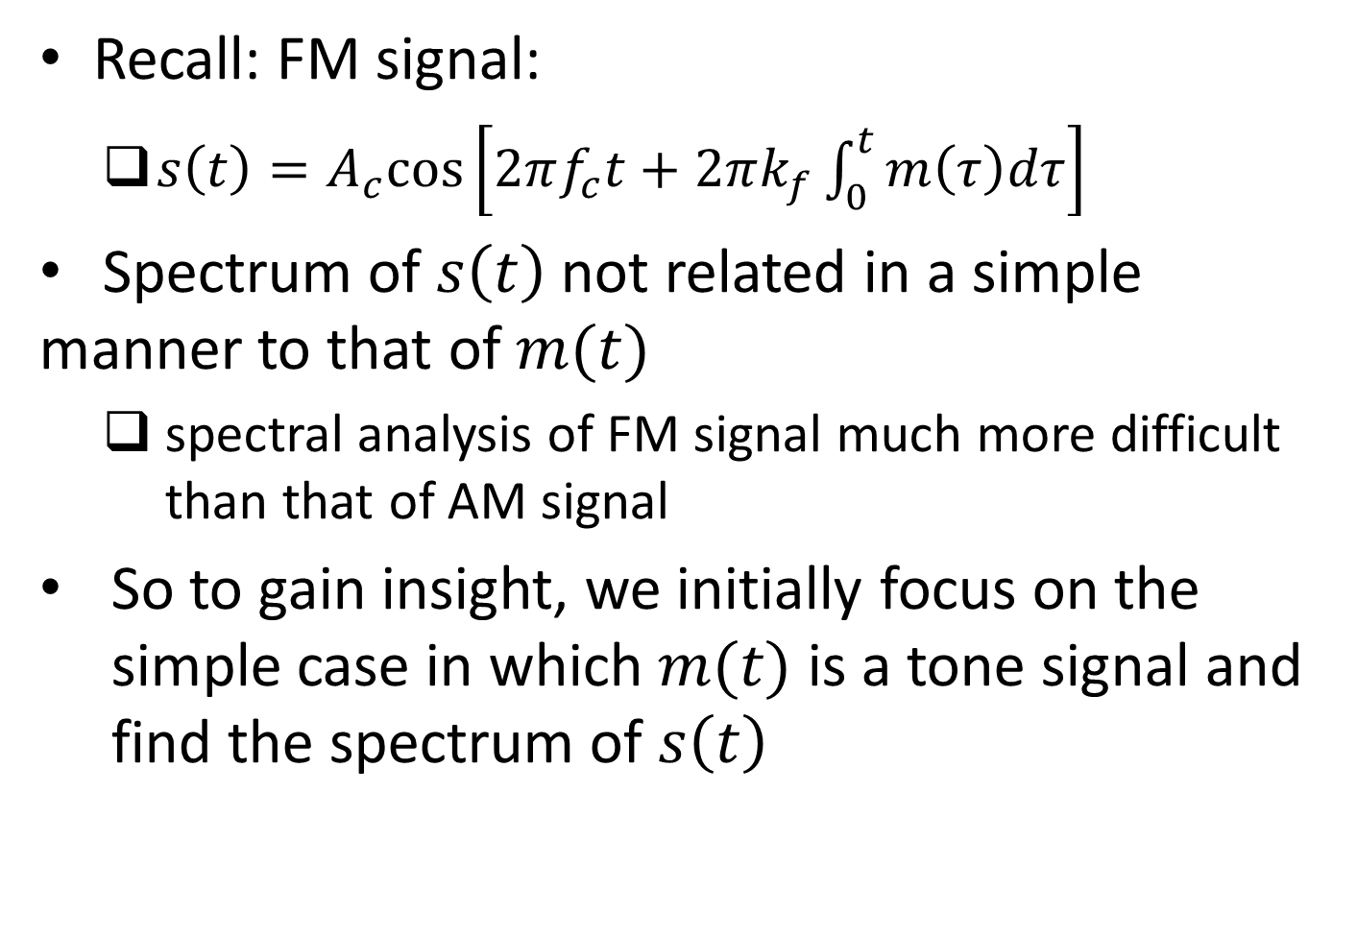
Spectral Analysis of FM Signal
Recall: FM signal:
$s\left(t\right)=A_{c}cos\left[2πf_{c}t+2πk_{f}\int_{0}^{t}{m\left(τ\right)dτ}\right]$
Spectrum of $s\left(t\right)$ not related in a simple manner to that of $m(t)$
spectral analysis of FM signal much more difficult than that of AM signal
So to gain insight, we initially focus on the simple case in which $m(t)$ is a tone signal and find the spectrum of $s\left(t\right)$

Slide 14
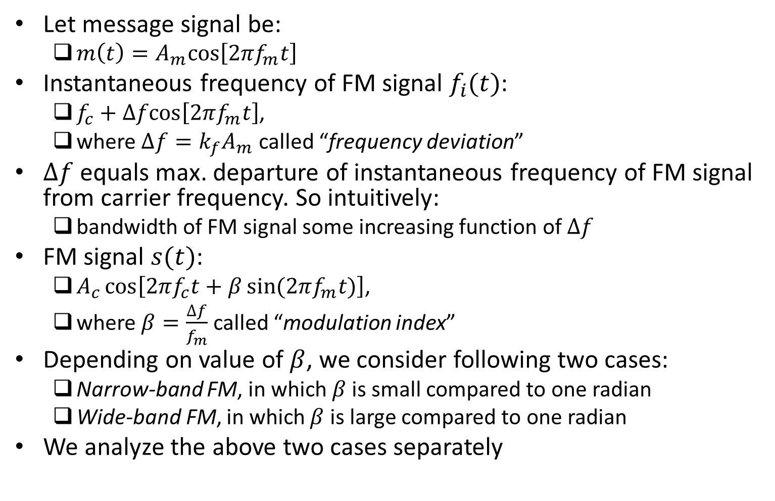
Spectral Analysis of FM Signal (contd.)
Let message signal be:
$m\left(t\right)=A_{m}cos\left[2πf_{m}t\right]$
Instantaneous frequency of FM signal $f_{i}(t)$:
$f_{c}+∆fcos\left[2πf_{m}t\right]$,
where $∆f=k_{f}A_{m}$ called “frequency deviation”
$∆f$ equals max. departure of instantaneous frequency of FM signal from carrier frequency. So intuitively:
bandwidth of FM signal some increasing function of $∆f$
FM signal $s(t)$:
$A_{c}\cos\left[2πf_{c}t+β\sin{(2πf_{m}t)}\right]$,
where $β=\frac{∆f}{f_{m}}$ called “modulation index”
Depending on value of $β$, we consider following two cases:
Narrow-band FM, in which $β$ is small compared to one radian
Wide-band FM, in which $β$ is large compared to one radian
We analyze the above two cases separately

Slide 15
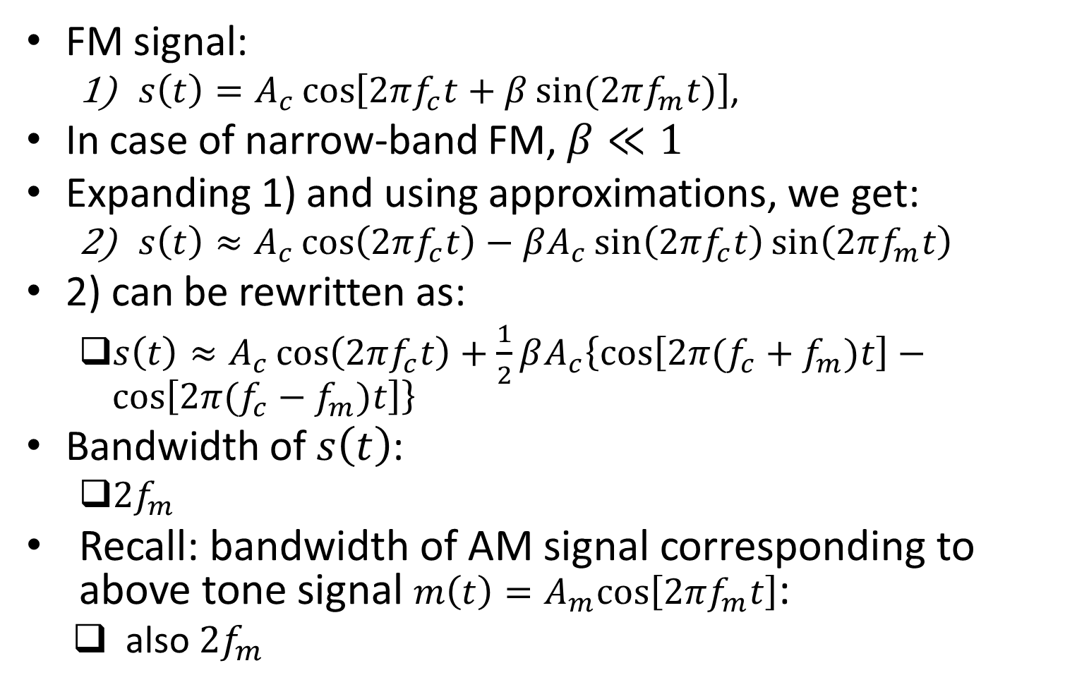
Narrow-Band FM
FM signal:
$s\left(t\right)=A_{c}\cos\left[2πf_{c}t+β\sin{(2πf_{m}t)}\right]$,
In case of narrow-band FM, $β≪1$
Expanding 1) and using approximations, we get:
$s\left(t\right)≈A_{c}\cos\left(2πf_{c}t\right)−βA_{c}\sin\left(2πf_{c}t\right)\sin\left(2πf_{m}t\right)$
2) can be rewritten as:
$s\left(t\right)≈A_{c}\cos\left(2πf_{c}t\right)+\frac{1}{2}βA_{c}\left\{\cos\left[2π(f_{c}+f_{m})t\right]−\cos\left[2π(f_{c}−f_{m})t\right]\right\}$
Bandwidth of $s\left(t\right)$:
${2f}_{m}$
Recall: bandwidth of AM signal corresponding to above tone signal $m\left(t\right)=A_{m}cos\left[2πf_{m}t\right]$:
also ${2f}_{m}$

Slide 16
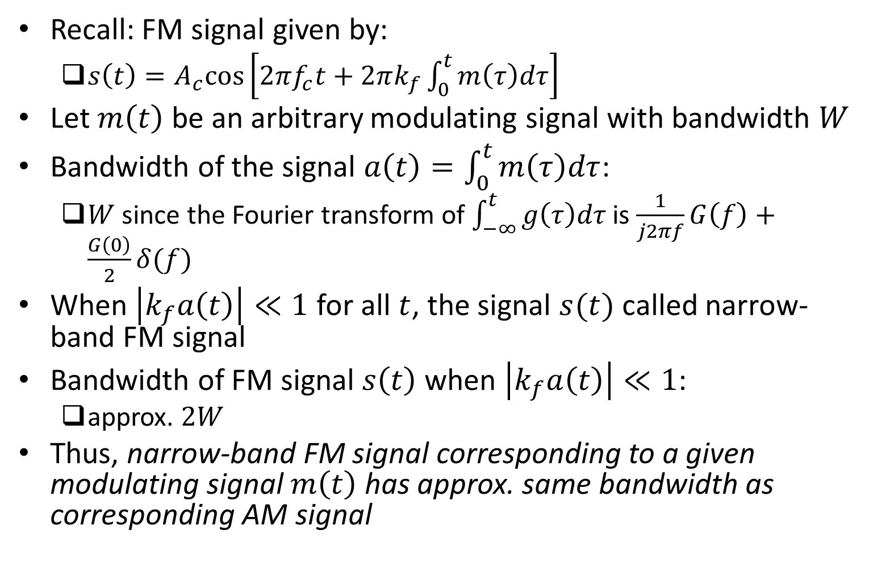
Narrow-Band FM: Generalization
Recall: FM signal given by:
$s\left(t\right)=A_{c}cos\left[2πf_{c}t+2πk_{f}\int_{0}^{t}{m\left(τ\right)dτ}\right]$
Let $m\left(t\right)$ be an arbitrary modulating signal with bandwidth $W$
Bandwidth of the signal $a\left(t\right)=\int_{0}^{t}{m\left(τ\right)dτ}$:
$W$ since the Fourier transform of $\int_{−∞}^{t}{g\left(τ\right)dτ}$ is $\frac{1}{j2πf}G\left(f\right)+\frac{G\left(0\right)}{2}δ(f)$
When $\left|k_{f}a\left(t\right)\right|≪1$ for all $t$, the signal $s(t)$ called narrow-band FM signal
Bandwidth of FM signal $s\left(t\right)$ when $\left|k_{f}a\left(t\right)\right|≪1$:
approx. $2W$
Thus, narrow-band FM signal corresponding to a given modulating signal $m\left(t\right)$ has approx. same bandwidth as corresponding AM signal

Slide 17
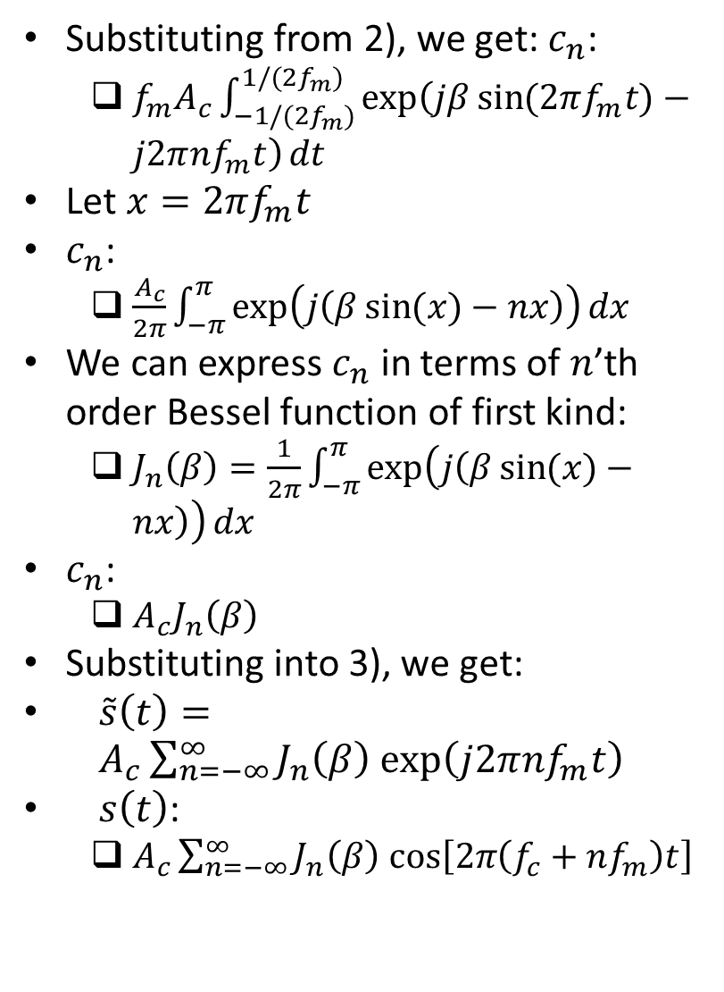
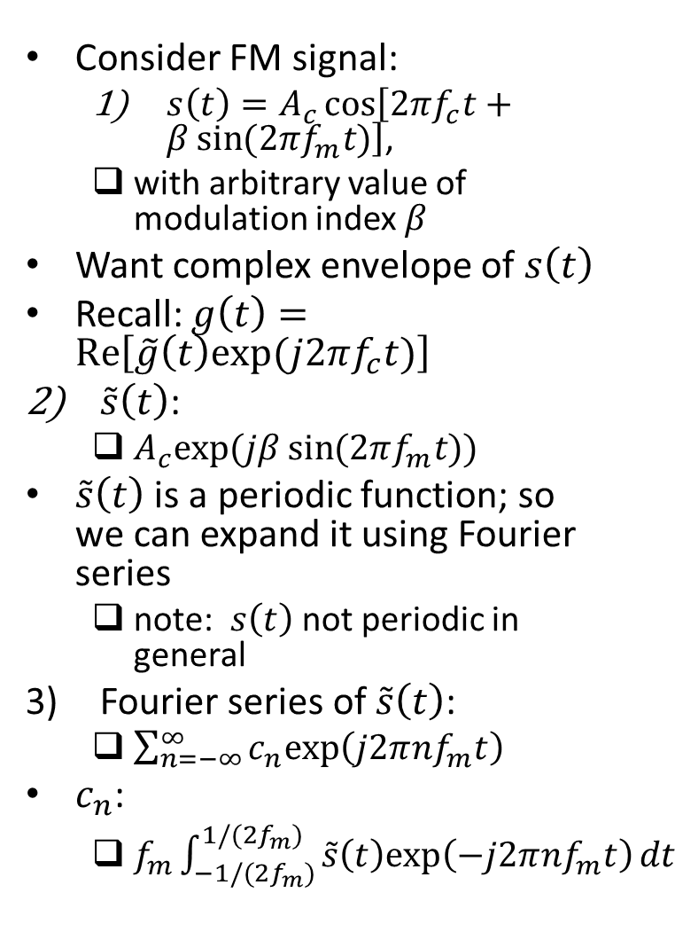
Wide-Band FM
Substituting from 2), we get: $c_{n}$:
$f_{m}A_{c}\int_{−1/(2f_{m})}^{1/(2f_{m})}{exp\left(jβ\sin{(2πf_{m}t)}−j2π{nf}_{m}t\right)}dt$
Let $x=2πf_{m}t$
$c_{n}$:
$\frac{A_{c}}{2π}\int_{−π}^{π}{exp\left(j\left(β\sin{(x)}−nx\right)\right)}dx$
We can express $c_{n}$ in terms of $n$’th order Bessel function of first kind:
$J_{n}\left(β\right)=\frac{1}{2π}\int_{−π}^{π}{exp\left(j\left(β\sin{(x)}−nx\right)\right)}dx$
$c_{n}$:
$A_{c}J_{n}\left(β\right)$
Substituting into 3), we get:
$\tilde{s}\left(t\right)=A_{c}\sum_{n=−∞}^{∞}{J_{n}\left(β\right) exp\left(j2π{nf}_{m}t\right)}$
$s\left(t\right)$:
$A_{c}\sum_{n=−∞}^{∞}{J_{n}\left(β\right) cos\left[2π\left(f_{c}+nf_{m}\right)t\right]}$
Consider FM signal:
$s\left(t\right)=A_{c}\cos\left[2πf_{c}t+β\sin{(2πf_{m}t)}\right]$,
with arbitrary value of modulation index $β$
Want complex envelope of $s\left(t\right)$
Recall: $g\left(t\right)=Re\left[\tilde{g}\left(t\right)exp⁡(j2πf_{c}t)\right]$
$\tilde{s}\left(t\right)$:
$A_{c}exp⁡(jβ\sin{(2πf_{m}t)})$
$\tilde{s}\left(t\right)$ is a periodic function; so we can expand it using Fourier series
note: $s\left(t\right)$ not periodic in general
Fourier series of $\tilde{s}\left(t\right)$:
$\sum_{n=−∞}^{∞}{c_{n}exp\left(j2π{nf}_{m}t\right)}$
$c_{n}$:
$f_{m}\int_{−1/(2f_{m})}^{1/(2f_{m})}{\tilde{s}\left(t\right)exp\left(−j2π{nf}_{m}t\right)}dt$

Slide 18
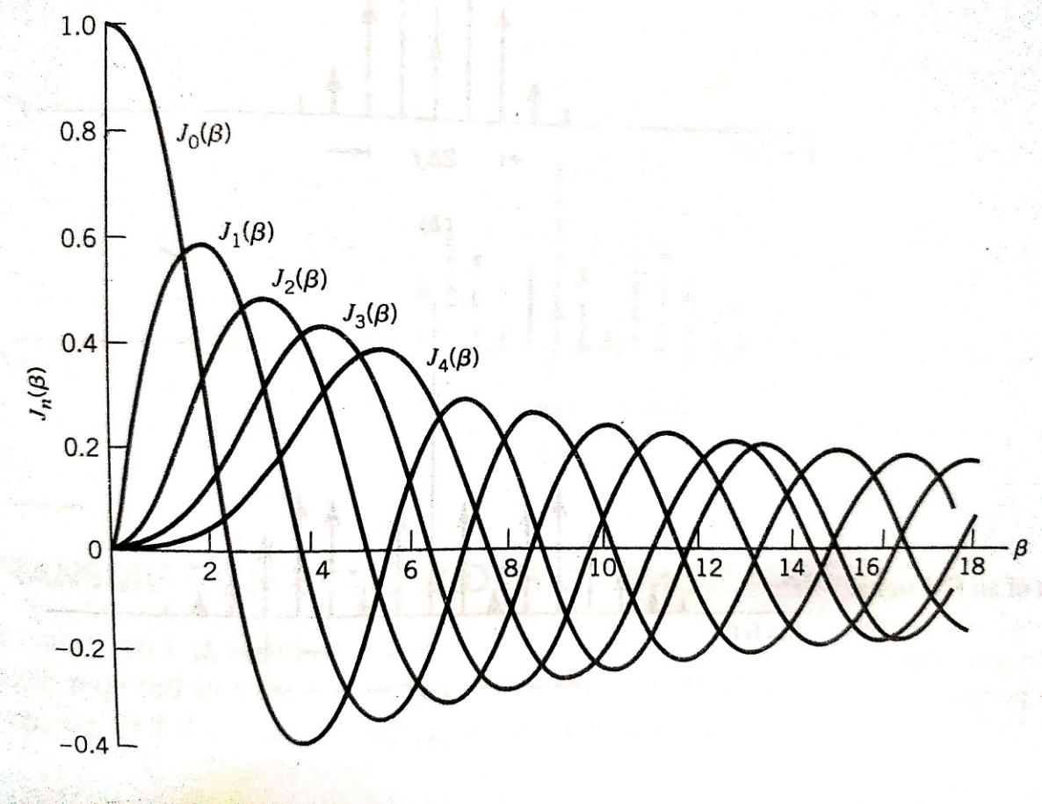
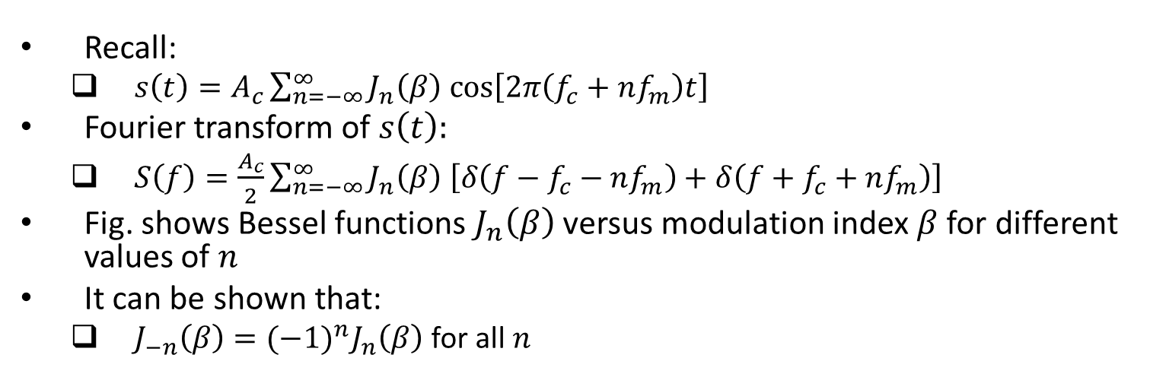
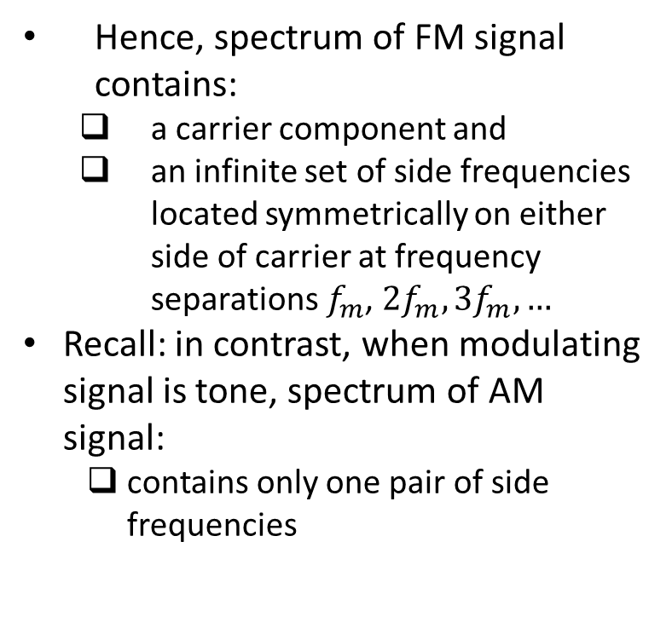
Wide-Band FM (contd.)
Recall:
$s\left(t\right)=A_{c}\sum_{n=−∞}^{∞}{J_{n}\left(β\right) cos\left[2π\left(f_{c}+nf_{m}\right)t\right]}$
Fourier transform of $s\left(t\right):$
$S\left(f\right)=\frac{A_{c}}{2}\sum_{n=−∞}^{∞}{J_{n}\left(β\right) \left[δ\left(f−f_{c}−nf_{m}\right)+δ\left(f+f_{c}+nf_{m}\right)\right]}$
Fig. shows Bessel functions $J_{n}\left(β\right)$ versus modulation index $β$ for different values of $n$
It can be shown that:
$J_{−n}\left(β\right)={(−1)}^{n}J_{n}\left(β\right)$ for all $n$
Hence, spectrum of FM signal contains:
a carrier component and
an infinite set of side frequencies located symmetrically on either side of carrier at frequency separations $f_{m}$, $2f_{m},3f_{m},…$
Recall: in contrast, when modulating signal is tone, spectrum of AM signal:
contains only one pair of side frequencies
Ref: “Communication Systems” by S. Haykin and M. Moher, 5th ed

Slide 19
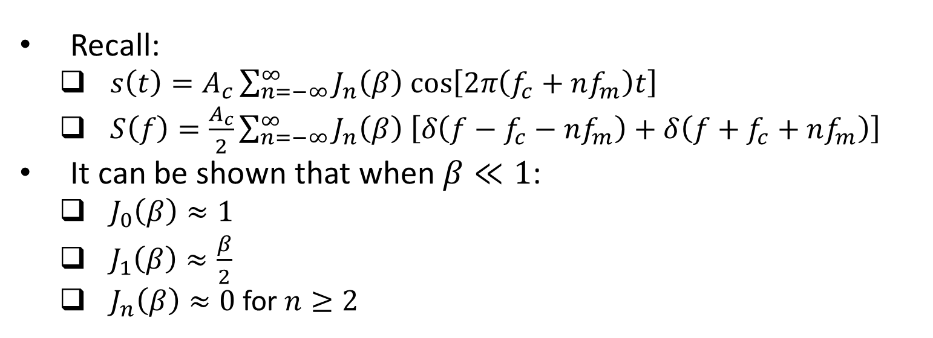
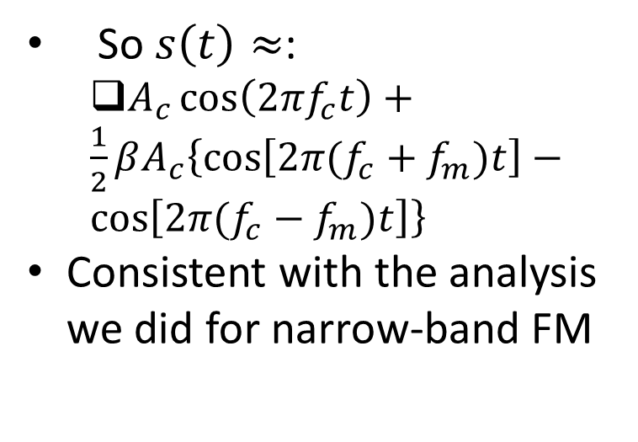
Wide-band FM (contd.)
Recall:
$s\left(t\right)=A_{c}\sum_{n=−∞}^{∞}{J_{n}\left(β\right) cos\left[2π\left(f_{c}+nf_{m}\right)t\right]}$
$S\left(f\right)=\frac{A_{c}}{2}\sum_{n=−∞}^{∞}{J_{n}\left(β\right) \left[δ\left(f−f_{c}−nf_{m}\right)+δ\left(f+f_{c}+nf_{m}\right)\right]}$
It can be shown that when $β≪1$:
$J_{0}\left(β\right)≈1$
$J_{1}\left(β\right)≈\frac{β}{2}$
$J_{n}\left(β\right)≈0$ for $n≥2$
So $s\left(t\right)≈$:
$A_{c}\cos\left(2πf_{c}t\right)+\frac{1}{2}βA_{c}\left\{\cos\left[2π(f_{c}+f_{m})t\right]−\cos\left[2π(f_{c}−f_{m})t\right]\right\}$
Consistent with the analysis we did for narrow-band FM
Ref: “Communication Systems” by S. Haykin and M. Moher, 5th ed

Slide 20
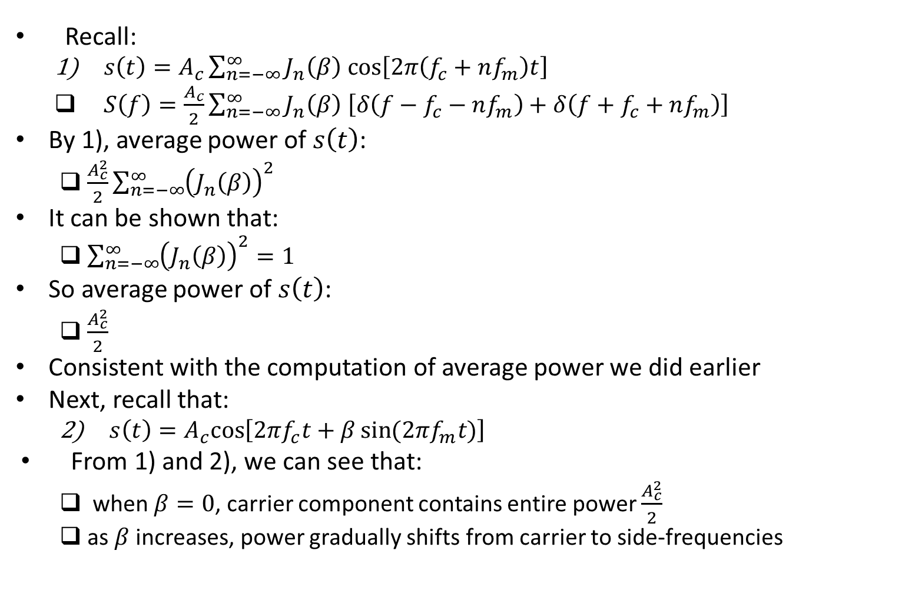
Wide-band FM (contd.)
Recall:
$s\left(t\right)=A_{c}\sum_{n=−∞}^{∞}{J_{n}\left(β\right) cos\left[2π\left(f_{c}+nf_{m}\right)t\right]}$
$S\left(f\right)=\frac{A_{c}}{2}\sum_{n=−∞}^{∞}{J_{n}\left(β\right) \left[δ\left(f−f_{c}−nf_{m}\right)+δ\left(f+f_{c}+nf_{m}\right)\right]}$
By 1), average power of $s\left(t\right)$:
$\frac{A_{c}^{2}}{2}\sum_{n=−∞}^{∞}{{\left(J_{n}\left(β\right)\right)}^{2}}$
It can be shown that:
$\sum_{n=−∞}^{∞}{{\left(J_{n}\left(β\right)\right)}^{2}=1}$
So average power of $s\left(t\right)$:
$\frac{A_{c}^{2}}{2}$
Consistent with the computation of average power we did earlier
Next, recall that:
$s\left(t\right)=A_{c}cos\left[2πf_{c}t+β\sin{(2πf_{m}t)}\right]$
From 1) and 2), we can see that:
when $β=0$, carrier component contains entire power $\frac{A_{c}^{2}}{2}$
as $β$ increases, power gradually shifts from carrier to side-frequencies

Slide 21
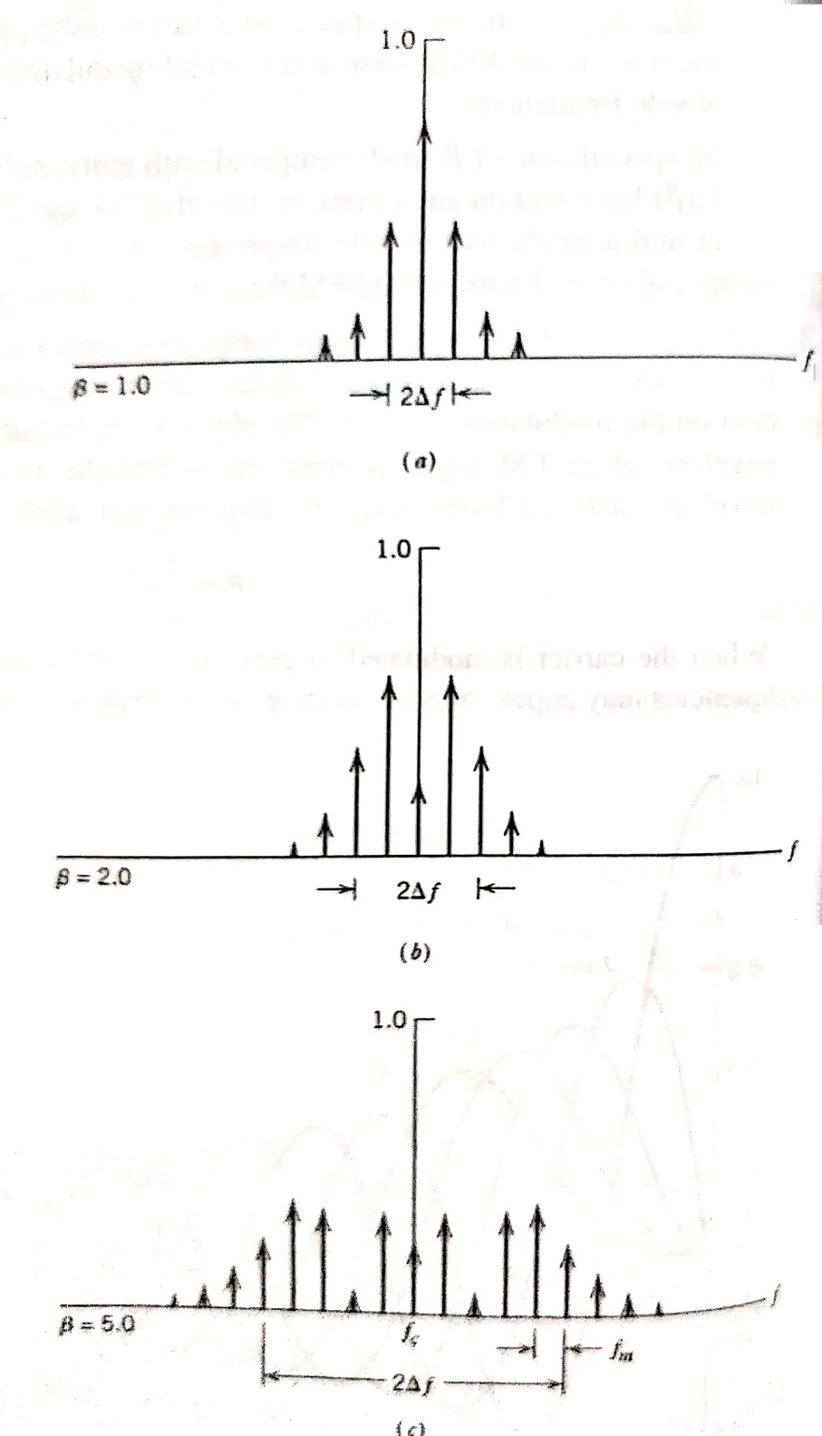
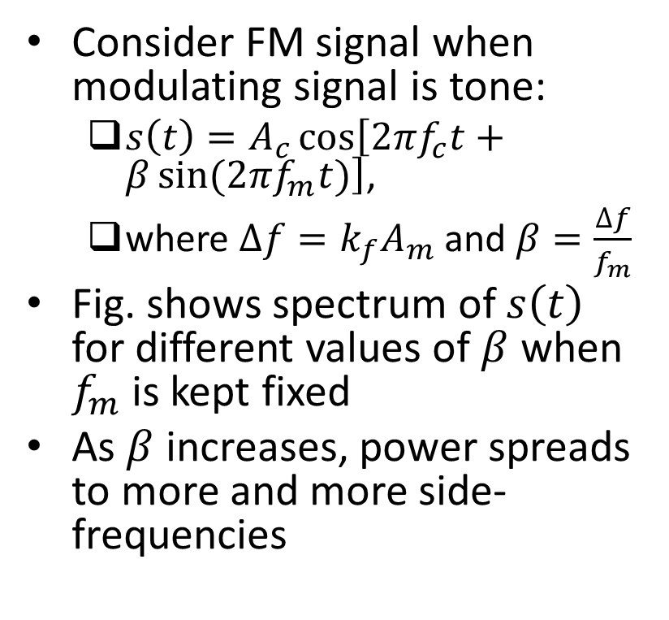
Example
Consider FM signal when modulating signal is tone:
$s\left(t\right)=A_{c}\cos\left[2πf_{c}t+β\sin{(2πf_{m}t)}\right]$,
where $∆f=k_{f}A_{m}$ and $β=\frac{∆f}{f_{m}}$
Fig. shows spectrum of $s\left(t\right)$ for different values of $β$ when $f_{m}$ is kept fixed
As $β$ increases, power spreads to more and more side-frequencies
Ref: “Communication Systems” by S. Haykin and M. Moher, 5th ed

Slide 22
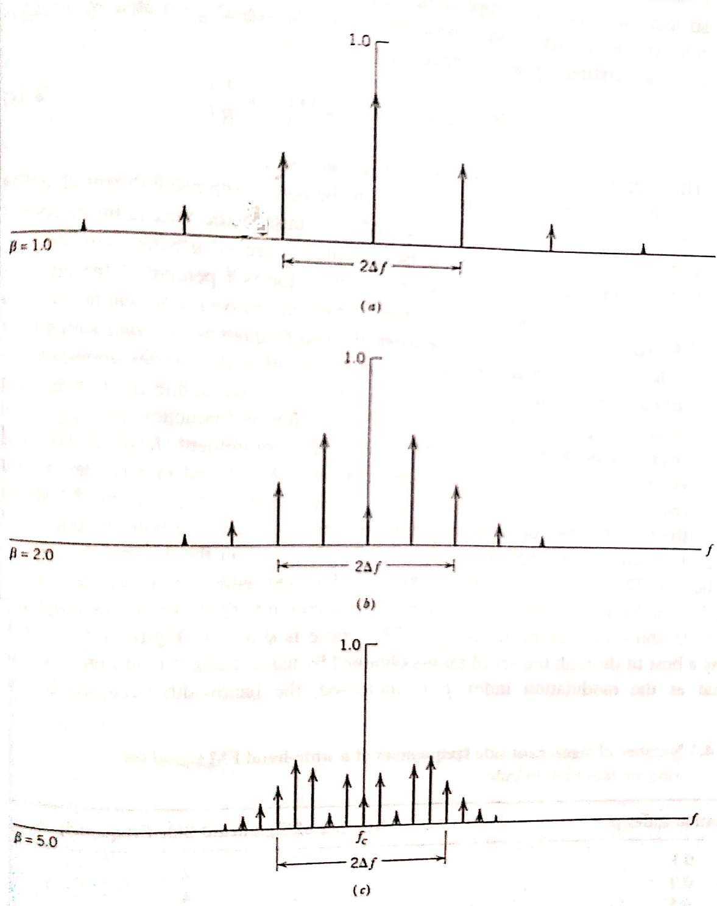
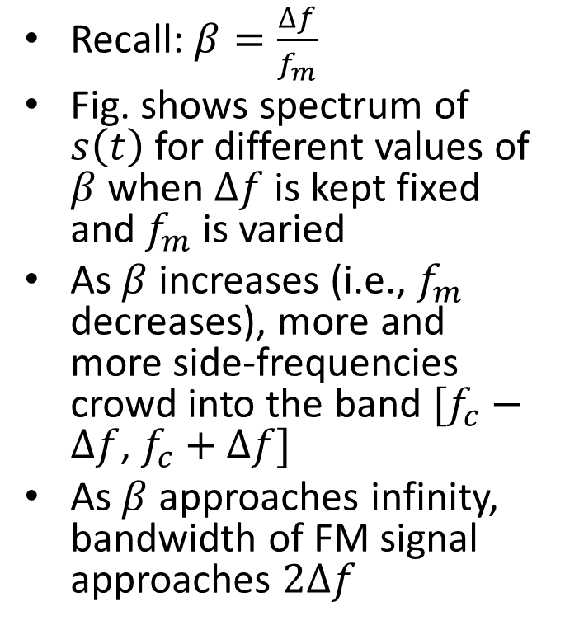
Example (contd.)
Recall: $β=\frac{∆f}{f_{m}}$
Fig. shows spectrum of $s\left(t\right)$ for different values of $β$ when $∆f$ is kept fixed and $f_{m}$ is varied
As $β$ increases (i.e., $f_{m}$ decreases), more and more side-frequencies crowd into the band $[f_{c}−∆f$, $f_{c}+∆f]$
As $β$ approaches infinity, bandwidth of FM signal approaches $2∆f$
Ref: “Communication Systems” by S. Haykin and M. Moher, 5th ed

Slide 23
Transmission Bandwidth of FM Signals

Slide 24
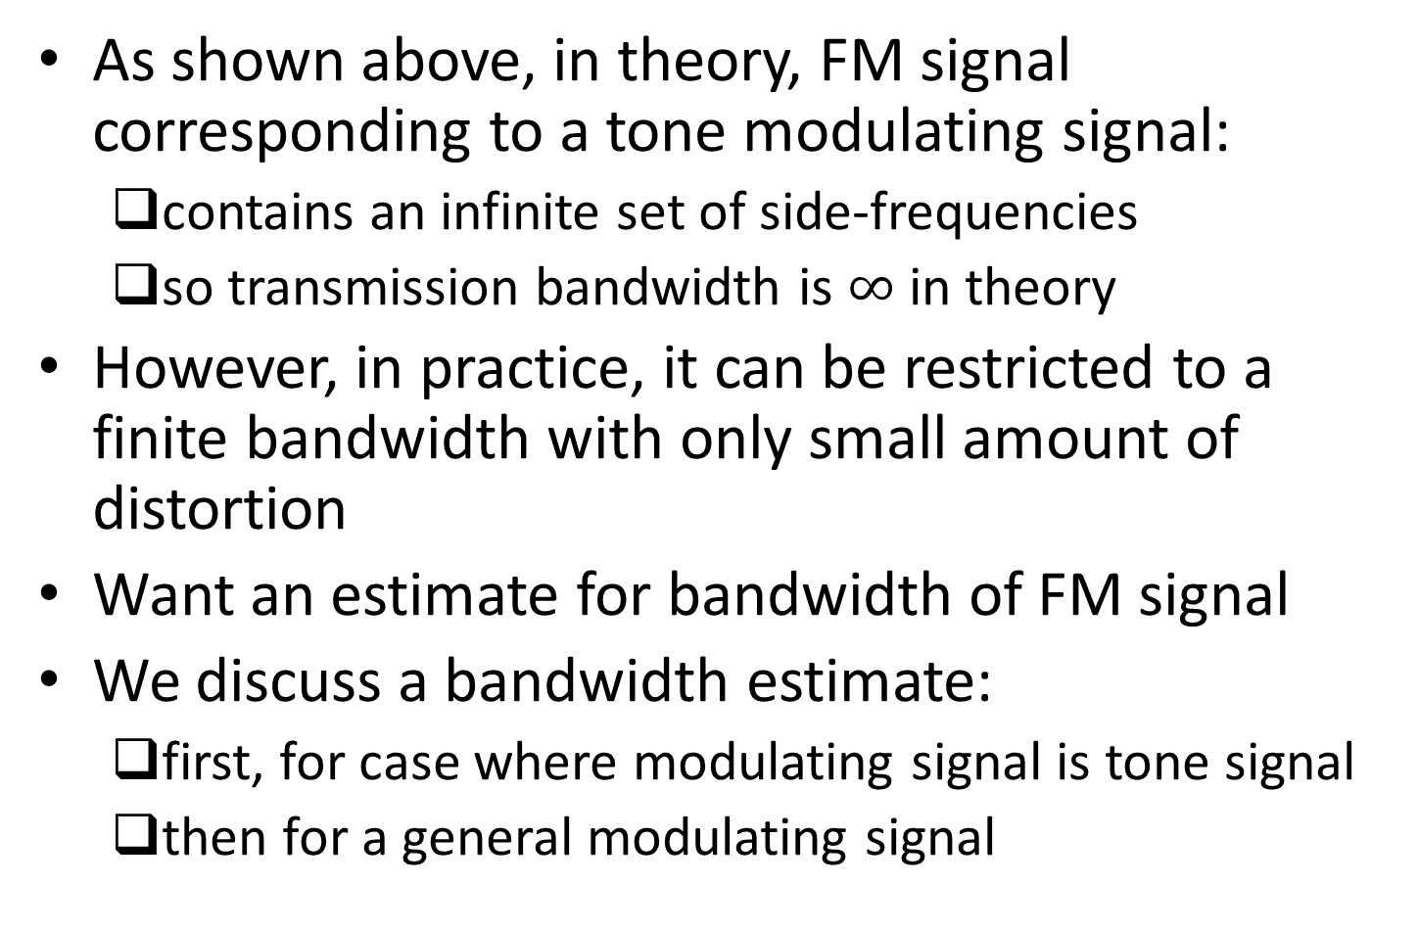
Transmission Bandwidth of FM Signals
As shown above, in theory, FM signal corresponding to a tone modulating signal:
contains an infinite set of side-frequencies
so transmission bandwidth is $∞$ in theory
However, in practice, it can be restricted to a finite bandwidth with only small amount of distortion
Want an estimate for bandwidth of FM signal
We discuss a bandwidth estimate:
first, for case where modulating signal is tone signal
then for a general modulating signal

Slide 25
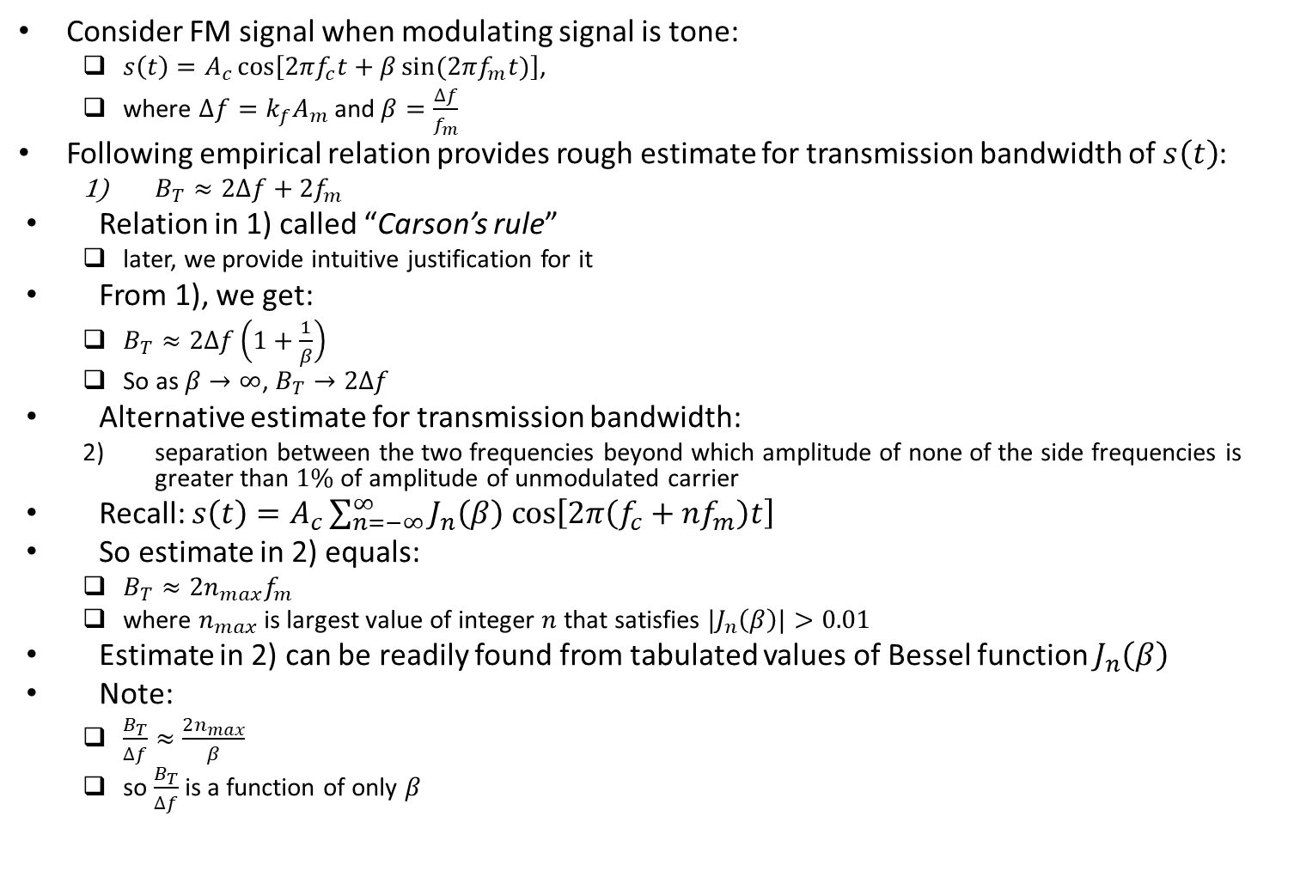
Transmission Bandwidth of FM Signals (contd.)
Consider FM signal when modulating signal is tone:
$s\left(t\right)=A_{c}\cos\left[2πf_{c}t+β\sin{(2πf_{m}t)}\right]$,
where $∆f=k_{f}A_{m}$ and $β=\frac{∆f}{f_{m}}$
Following empirical relation provides rough estimate for transmission bandwidth of $s\left(t\right)$:
$B_{T}≈2∆f+2f_{m}$
Relation in 1) called “Carson’s rule”
later, we provide intuitive justification for it
From 1), we get:
$B_{T}≈2∆f\left(1+\frac{1}{β}\right)$
So as $β→∞$, $B_{T}→2∆f$
Alternative estimate for transmission bandwidth:
separation between the two frequencies beyond which amplitude of none of the side frequencies is greater than $1\%$ of amplitude of unmodulated carrier
Recall: $s\left(t\right)=A_{c}\sum_{n=−∞}^{∞}{J_{n}\left(β\right) cos\left[2π\left(f_{c}+nf_{m}\right)t\right]}$
So estimate in 2) equals:
$B_{T}≈2n_{max}f_{m}$
where $n_{max}$ is largest value of integer $n$ that satisfies ${|J}_{n}\left(β\right)|>0.01$
Estimate in 2) can be readily found from tabulated values of Bessel function $J_{n}\left(β\right)$
Note:
$\frac{B_{T}}{∆f}≈\frac{2n_{max}}{β}$
so $\frac{B_{T}}{∆f}$ is a function of only $β$

Slide 26
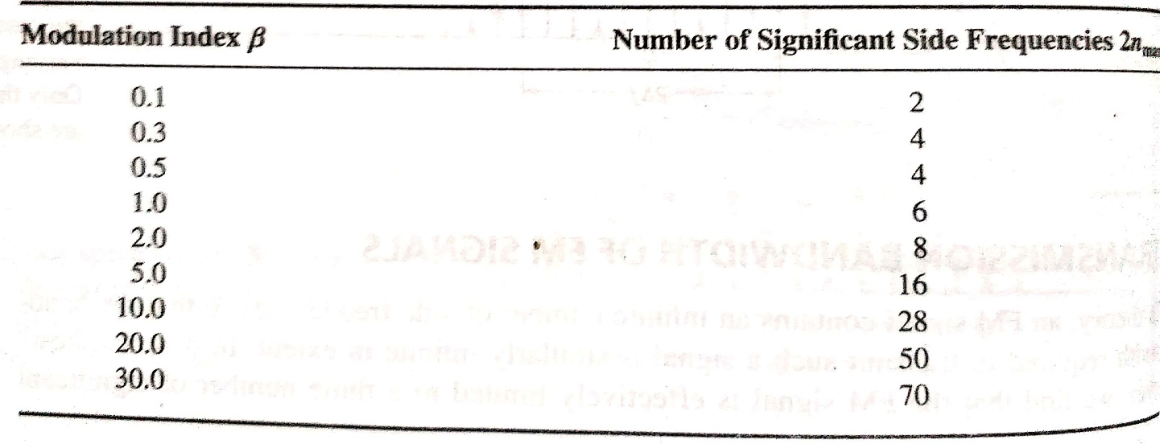
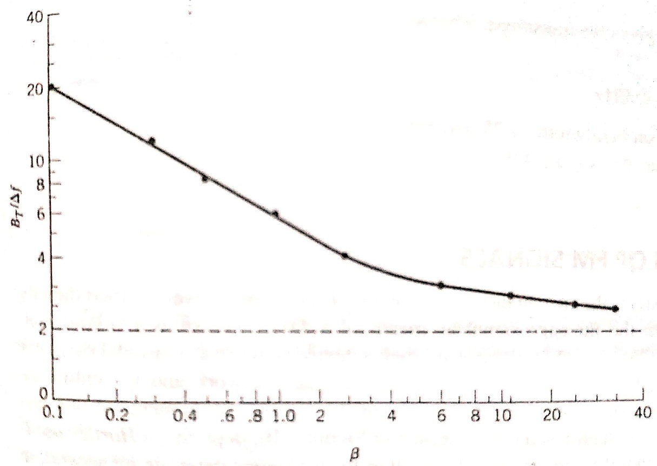
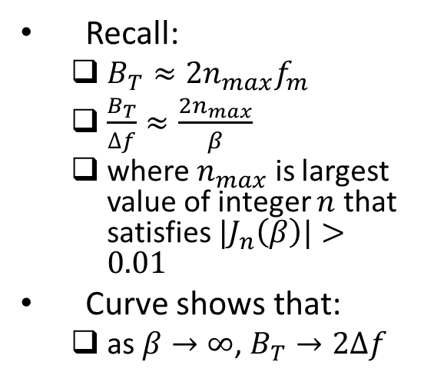
Transmission Bandwidth of FM Signals (contd.)
Recall:
$B_{T}≈2n_{max}f_{m}$
$\frac{B_{T}}{∆f}≈\frac{2n_{max}}{β}$
where $n_{max}$ is largest value of integer $n$ that satisfies ${|J}_{n}\left(β\right)|>0.01$
Curve shows that:
as $β→∞$, $B_{T}→2∆f$
Ref: “Communication Systems” by S. Haykin and M. Moher, 5th ed

Slide 27
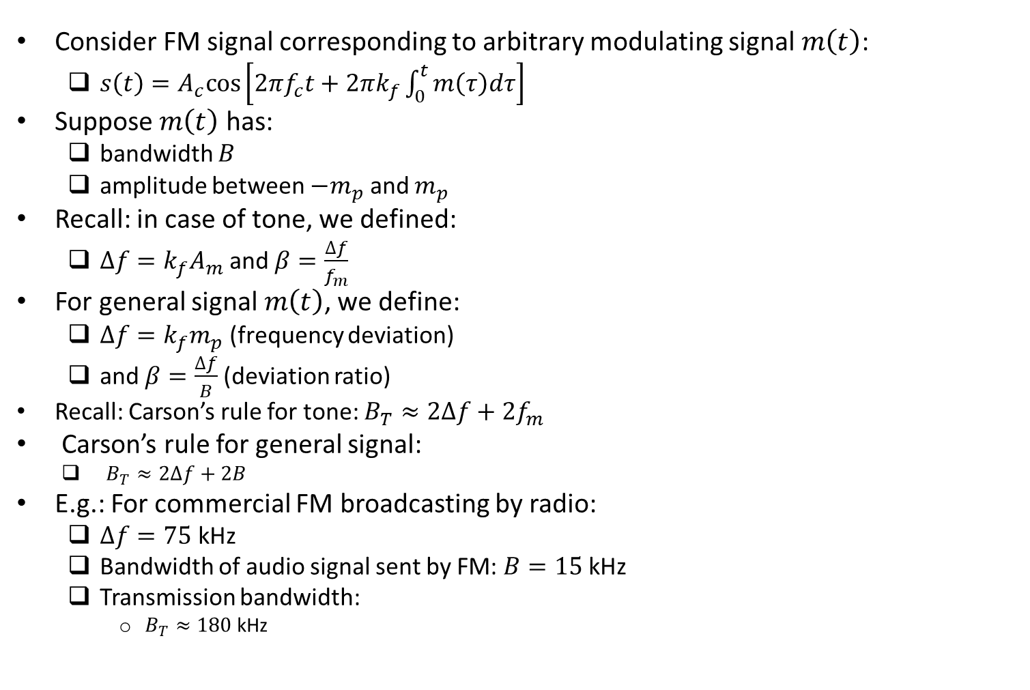
Transmission Bandwidth of FM Signals: Generalization
Consider FM signal corresponding to arbitrary modulating signal $m\left(t\right)$:
$s\left(t\right)=A_{c}cos\left[2πf_{c}t+2πk_{f}\int_{0}^{t}{m\left(τ\right)dτ}\right]$
Suppose $m\left(t\right)$ has:
bandwidth $B$
amplitude between $−m_{p}$ and $m_{p}$
Recall: in case of tone, we defined:
$∆f=k_{f}A_{m}$ and $β=\frac{∆f}{f_{m}}$
For general signal $m\left(t\right)$, we define:
$∆f=k_{f}m_{p}$ (frequency deviation)
and $β=\frac{∆f}{B}$ (deviation ratio)
Recall: Carson’s rule for tone: $B_{T}≈2∆f+2f_{m}$
Carson’s rule for general signal:
$B_{T}≈2∆f+2B$
E.g.: For commercial FM broadcasting by radio:
$∆f=75$ kHz
Bandwidth of audio signal sent by FM: $B=15$ kHz
Transmission bandwidth:
$B_{T}≈180$ kHz

Slide 28
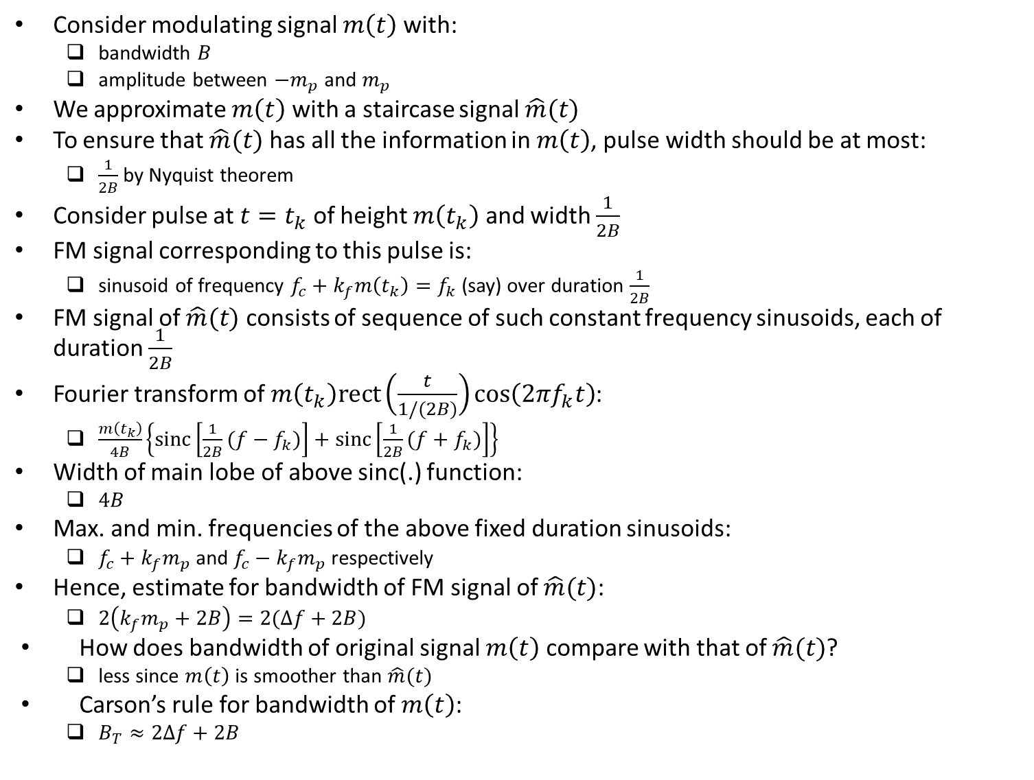
Informal Justification for Carson’s Rule
Consider modulating signal $m\left(t\right)$ with:
bandwidth $B$
amplitude between $−m_{p}$ and $m_{p}$
We approximate $m\left(t\right)$ with a staircase signal $\hat{m}(t)$
To ensure that $\hat{m}(t)$ has all the information in $m\left(t\right)$, pulse width should be at most:
$\frac{1}{2B}$ by Nyquist theorem
Consider pulse at $t=t_{k}$ of height $m\left(t_{k}\right)$ and width $\frac{1}{2B}$
FM signal corresponding to this pulse is:
sinusoid of frequency $f_{c}+k_{f}m\left(t_{k}\right)=f_{k}$ (say) over duration $\frac{1}{2B}$
FM signal of $\hat{m}(t)$ consists of sequence of such constant frequency sinusoids, each of duration $\frac{1}{2B}$
Fourier transform of $m\left(t_{k}\right)rect\left(\frac{t}{1/(2B)}\right)\cos\left(2πf_{k}t\right)$:
$\frac{m\left(t_{k}\right)}{4B}\left\{sinc\left[\frac{1}{2B}(f−f_{k})\right]+sinc\left[\frac{1}{2B}(f+f_{k})\right]\right\}$
Width of main lobe of above sinc(.) function:
$4B$
Max. and min. frequencies of the above fixed duration sinusoids:
$f_{c}+k_{f}m_{p}$ and $f_{c}−k_{f}m_{p}$ respectively
Hence, estimate for bandwidth of FM signal of $\hat{m}(t)$:
$2\left(k_{f}m_{p}+2B\right)=2(∆f+2B)$
How does bandwidth of original signal $m\left(t\right)$ compare with that of $\hat{m}(t)$?
less since $m\left(t\right)$ is smoother than $\hat{m}(t)$
Carson’s rule for bandwidth of $m\left(t\right)$:
$B_{T}≈2∆f+2B$

Slide 29
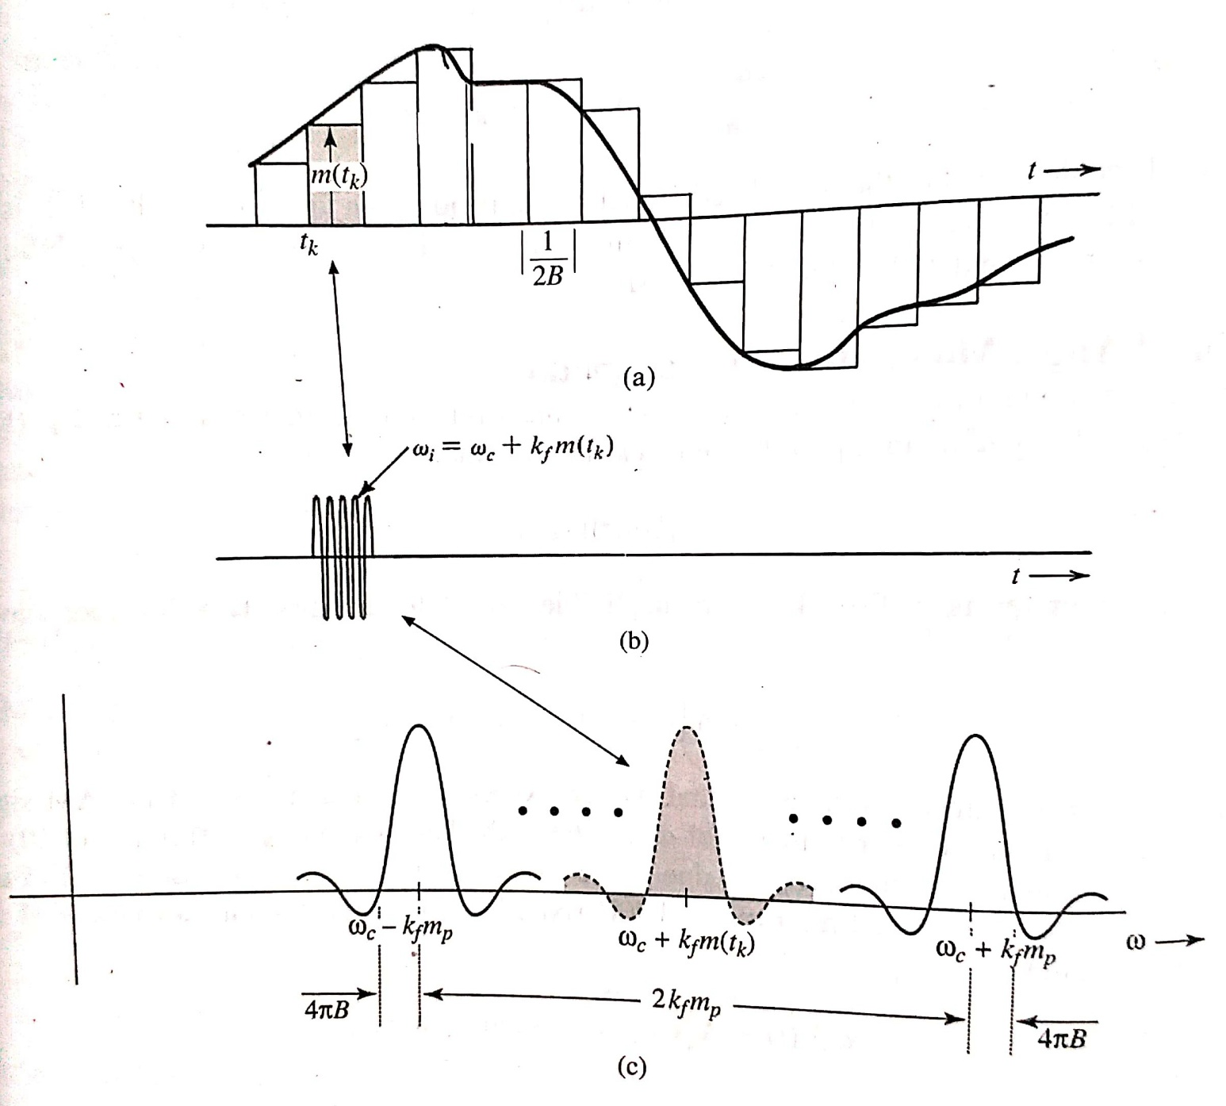
Informal Justification for Carson’s Rule (contd.)
Ref: B.P. Lathi, Z. Ding, “Modern Digital and Analog Communication Systems”, 4th ed.

